Slide 1

Consulting Prosal
BOSCH's Route Optimization Algorithm

Slide 2
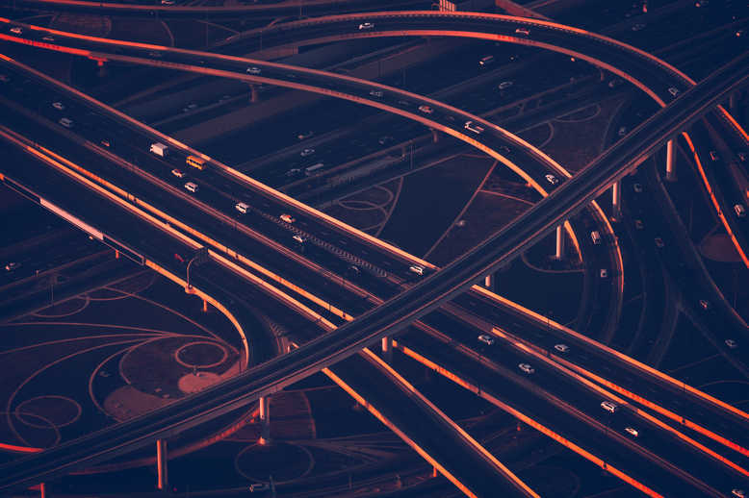
Objective
To develop a route optimization algorithm to determine route and schedule of buses depending on the constraints provided.
CONSTRAINTS:
Time window for pick up and drop off.
Minimize operational cost.
Number of buses
Vehicle occupancy should be at least 85%.

Slide 3
Our Algorithm

Slide 4
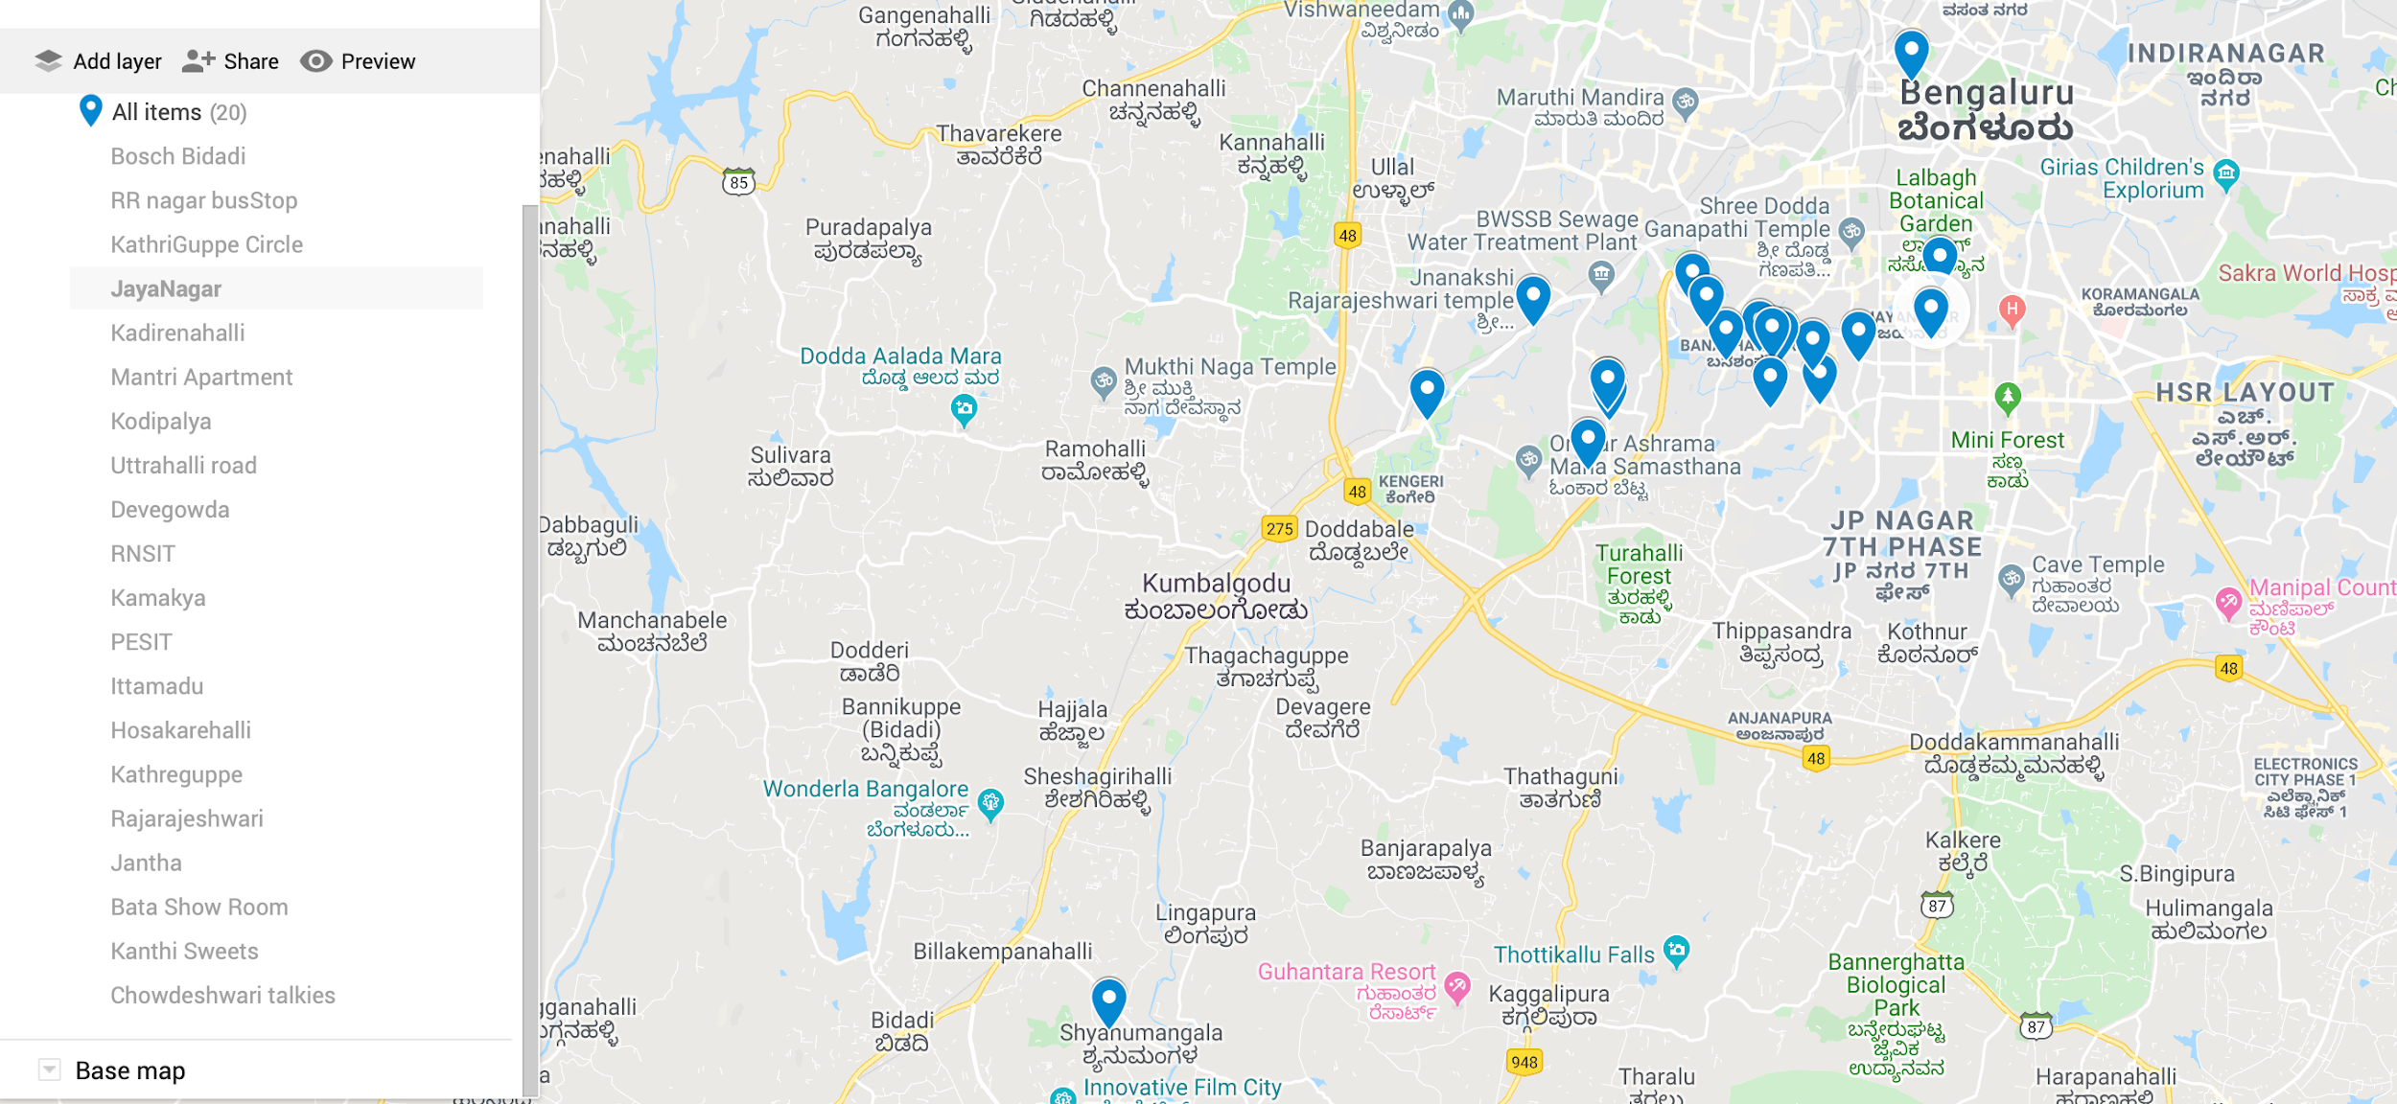
Nearest Bus stop to the given location was taken as the pickup point

Slide 5
DATASET
Addresses | Number of Passengers | Latitude | Longitude
Bosch Bidadi | 0 | 12.797118 | 77.423885
RR nagar busStop | 5 | 12.914682 | 77.520583
KathriGuppe Circle | 4 | 12.925495 | 77.550119
JayaNagar | 5 | 12.9279 | 77.58355
Kadirenahalli | 4 | 12.915613 | 77.561685
Mantri Apartment | 6 | 12.937671 | 77.585208
Kodipalya | 4 | 12.912695 | 77.520808
Uttrahalli road | 6 | 12.912444 | 77.485435
Devegowda | 6 | 12.921923 | 77.56051
RNSIT | 5 | 12.90322 | 77.516645
Kamakya | 5 | 12.923769 | 77.554121
PESIT | 4 | 12.934796 | 77.5371
Ittamadu | 4 | 12.923999 | 77.543628
Hosakarehalli | 4 | 12.930326 | 77.539626
Kathreguppe | 6 | 12.924313 | 77.55263
Rajarajeshwari | 5 | 12.930221 | 77.506024
Jantha | 5 | 12.976791 | 77.579634
Bata Show Room | 4 | 12.923733 | 77.569355
Kanthi Sweets | 6 | 12.914666 | 77.520593
Chowdeshwari talkies | 4 | 12.915027 | 77.551986

Slide 6
Variables
n=Total number of passengers=92
m=maximum occupancy in each bus=32
minOcc=minimum occupancy in each bus = ⌈85/100 x m⌉=28
minBuses = minimum number of Buses= ⌈n/m⌉=3

Slide 7
Distance and Time Matrix
01
Distance matrix and Time matrix was made using Microsoft’s API.
https://dev.virtualearth.net/REST/v1/Routes/DistanceMatrix?

Slide 8
Distance Matrix
[[0, 24.24, 31.3, 37.1, 34.06, 33.57, 24.47, 17.71, 32.97, 21.79, 32.97, 29.79, 31.37, 30.73, 31.84, 20.86, 32.4, 34.81, 24.24, 32.94],
[24.24, 0, 5.33, 11.13, 6.13, 12.43, 0.23, 5.61, 7.0, 1.83, 7.0, 5.15, 4.79, 3.46, 5.87, 4.29, 13.28, 8.84, 0.0, 5.34],
[31.3, 5.33, 0, 5.82, 2.78, 5.28, 5.55, 9.46, 1.69, 5.88, 1.69, 1.88, 1.32, 1.87, 0.56, 7.44, 11.96, 3.53, 5.33, 1.66],
[37.1, 11.13, 5.82, 0, 4.0, 1.72, 10.88, 15.26, 4.67, 9.89, 5.37, 7.69, 7.13, 7.67, 5.82, 13.25, 7.23, 2.89, 11.13, 5.67],
[34.06, 6.13, 2.78, 4.0, 0, 5.27, 6.49, 12.22, 1.36, 5.9, 2.33, 4.64, 4.08, 4.63, 2.78, 10.2, 11.81, 2.1, 6.13, 1.67],
[33.57, 12.43, 5.28, 1.72, 5.27, 0, 12.66, 15.88, 4.45, 10.86, 5.42, 7.0, 6.66, 6.98, 5.3, 13.86, 7.08, 3.81, 12.43, 6.14],
[24.47, 0.23, 5.55, 10.88, 6.49, 12.66, 0, 5.61, 7.23, 1.61, 7.23, 5.38, 5.15, 3.68, 6.1, 4.52, 13.51, 8.59, 0.23, 5.7],
[17.71, 5.61, 9.46, 15.26, 12.22, 15.88, 5.61, 0, 11.13, 4.08, 11.13, 7.95, 9.53, 8.22, 10.0, 3.16, 14.71, 12.97, 5.61, 11.1],
[32.97, 7.0, 1.69, 4.67, 1.36, 4.45, 7.23, 11.13, 0, 6.43, 1.24, 3.56, 3.0, 3.54, 1.69, 9.11, 10.61, 2.1, 7.0, 1.7],
[21.79, 1.83, 5.88, 9.89, 5.9, 10.86, 1.61, 4.08, 6.43, 0, 6.89, 6.86, 4.56, 5.29, 6.89, 5.32, 14.38, 7.94, 1.83, 5.11],
[32.97, 7.0, 1.69, 5.37, 2.33, 5.42, 7.23, 11.13, 1.24, 6.89, 0, 3.56, 3.0, 3.54, 1.69, 9.11, 10.35, 3.08, 7.0, 2.26],
[29.79, 5.15, 1.88, 7.69, 4.64, 7.0, 5.38, 7.95, 3.56, 6.86, 3.56, 0, 1.96, 1.31, 2.43, 5.93, 10.45, 5.4, 5.15, 3.52],
[31.37, 4.79, 1.32, 7.13, 4.08, 6.66, 5.15, 9.53, 3.0, 4.56, 3.0, 1.96, 0, 1.94, 1.87, 7.52, 12.04, 4.84, 4.79, 2.03],
[30.73, 3.46, 1.87, 7.67, 4.63, 6.98, 3.68, 8.22, 3.54, 5.29, 3.54, 1.31, 1.94, 0, 2.42, 6.2, 11.39, 5.38, 3.46, 3.51],
[31.84, 5.87, 0.56, 5.82, 2.78, 5.3, 6.1, 10.0, 1.69, 6.89, 1.69, 2.43, 1.87, 2.42, 0, 7.99, 10.35, 3.53, 5.87, 1.66],
[20.86, 4.29, 7.44, 13.25, 10.2, 13.86, 4.52, 3.16, 9.11, 5.32, 9.11, 5.93, 7.52, 6.2, 7.99, 0, 12.69, 10.96, 4.29, 9.08],
[32.4, 13.28, 11.96, 7.23, 11.81, 7.08, 13.51, 14.71, 10.61, 14.38, 10.35, 10.45, 12.04, 11.39, 10.35, 12.69, 0, 8.09, 13.28, 13.6],
[34.81, 8.84, 3.53, 2.89, 2.1, 3.81, 8.59, 12.97, 2.1, 7.94, 3.08, 5.4, 4.84, 5.38, 3.53, 10.96, 8.09, 0, 8.84, 3.6],
[24.24, 0.0, 5.33, 11.13, 6.13, 12.43, 0.23, 5.61, 7.0, 1.83, 7.0, 5.15, 4.79, 3.46, 5.87, 4.29, 13.28, 8.84, 0, 5.34],
[32.94, 5.34, 1.66, 5.67, 1.67, 6.14, 5.7, 11.1, 1.7, 5.11, 2.26, 3.52, 2.03, 3.51, 1.66, 9.08, 13.6, 3.6, 5.34, 0]]

Slide 9
Time matrix
[[0, 39.22, 40.58, 52.54, 44.06, 53.88, 39.57, 29.4, 41.45, 36.85, 41.45, 38.42, 40.91, 39.55, 40.82, 32.05, 49.03, 47.14, 39.22, 47.52],
[39.22, 0, 14.61, 26.57, 14.37, 27.44, 0.4, 10.35, 15.47, 4.08, 15.48, 12.5, 11.65, 9.32, 14.84, 8.25, 23.27, 21.17, 0.0, 14.38],
[40.58, 14.61, 0, 15.04, 6.56, 15.28, 15.02, 13.93, 3.95, 15.98, 3.68, 5.11, 5.37, 5.28, 3.03, 12.13, 20.26, 9.64, 14.61, 10.02],
[52.54, 26.57, 15.04, 0, 12.8, 5.96, 26.54, 25.89, 12.94, 26.13, 13.19, 17.07, 17.33, 17.24, 13.75, 24.1, 17.45, 9.71, 26.57, 19.07],
[44.06, 14.37, 6.56, 12.8, 0, 16.17, 14.38, 17.41, 4.63, 13.32, 4.71, 8.58, 8.85, 8.76, 5.27, 15.62, 24.04, 7.69, 14.37, 6.25],
[53.88, 27.44, 15.28, 5.96, 16.17, 0, 27.86, 25.76, 13.99, 28.66, 15.29, 18.61, 18.75, 18.78, 15.28, 23.96, 14.77, 12.18, 27.44, 21.26],
[39.57, 0.4, 15.02, 26.54, 14.38, 27.86, 0, 10.35, 15.89, 3.66, 15.9, 12.92, 11.67, 9.73, 15.26, 8.67, 23.68, 21.13, 0.4, 14.38],
[29.4, 10.35, 13.93, 25.89, 17.41, 25.76, 10.35, 0, 14.81, 7.43, 14.8, 11.77, 14.26, 12.59, 14.17, 3.93, 20.91, 20.49, 10.36, 20.11],
[41.45, 15.47, 3.95, 12.94, 4.63, 13.99, 15.89, 14.81, 0, 15.81, 2.1, 5.98, 6.23, 6.15, 2.66, 13.02, 21.01, 5.83, 15.48, 8.33],
[36.85, 4.08, 15.98, 26.13, 13.32, 28.66, 3.66, 7.43, 15.81, 0, 15.8, 15.06, 10.61, 13.39, 15.81, 10.18, 25.22, 20.86, 4.06, 13.32],
[41.45, 15.48, 3.68, 13.19, 4.71, 15.29, 15.9, 14.8, 2.1, 15.8, 0, 5.98, 6.24, 6.15, 2.66, 13.01, 20.23, 7.79, 15.48, 8.95],
[38.42, 12.5, 5.11, 17.07, 8.58, 18.61, 12.92, 11.77, 5.98, 15.06, 5.98, 0, 5.44, 4.08, 5.34, 9.97, 18.51, 11.68, 12.51, 12.05],
[40.91, 11.65, 5.37, 17.33, 8.85, 18.75, 11.67, 14.26, 6.23, 10.61, 6.24, 5.44, 0, 5.61, 5.6, 12.47, 21.0, 11.93, 11.66, 9.41],
[39.55, 9.32, 5.28, 17.24, 8.76, 18.78, 9.73, 12.59, 6.15, 13.39, 6.15, 4.08, 5.61, 0, 5.52, 10.8, 19.64, 11.84, 9.32, 12.22],
[40.82, 14.84, 3.03, 13.75, 5.27, 15.28, 15.26, 14.17, 2.66, 15.81, 2.66, 5.34, 5.6, 5.52, 0, 12.38, 20.22, 8.35, 14.84, 8.73],
[32.05, 8.25, 12.13, 24.1, 15.62, 23.96, 8.67, 3.93, 13.02, 10.18, 13.01, 9.97, 12.47, 10.8, 12.38, 0, 19.12, 18.69, 8.25, 19.08],
[49.03, 23.27, 20.26, 17.45, 24.04, 14.77, 23.68, 20.91, 21.01, 25.22, 20.23, 18.51, 21.0, 19.64, 20.22, 19.12, 0, 19.93, 23.27, 27.62],
[47.14, 21.17, 9.64, 9.71, 7.69, 12.18, 21.13, 20.49, 5.83, 20.86, 7.79, 11.68, 11.93, 11.84, 8.35, 18.69, 19.93, 0, 21.18, 13.7],
[39.22, 0.0, 14.61, 26.57, 14.37, 27.44, 0.4, 10.36, 15.48, 4.06, 15.48, 12.51, 11.66, 9.32, 14.84, 8.25, 23.27, 21.18, 0, 14.38],
[47.52, 14.38, 10.02, 19.07, 6.25, 21.26, 14.38, 20.11, 8.33, 13.32, 8.95, 12.05, 9.41, 12.22, 8.73, 19.08, 27.62, 13.7, 14.38, 0]]

Slide 10
INITIAL ROUTE GENERATION

Slide 11
Sort the pickup points according to the angle the line joining the pickup point and the depot makes with the vertical or horizontal line
02
Formula for finding the angle using latitudes and longitudes:
dlon=longitude(pickup)-longitude(depot) lat1=Latitude(Depot) lat2=Latitude(Pickup)
y = sin(dLon) * cos(lat2)
x =cos(lat1) * sin(lat2) - sin(lat1)* cos(lat2) * cos(dLon);
angle = tan^-1(y, x)

Slide 12
Order of pickup points according to the angle with vertical
Uttrahalli road , Rajarajeshwari , PESIT , RR nagar BusStop ,
Kanthi Sweets , Kodipalya , Jantha , Hosakarehalli , RNSIT , Ittamadu , KathriGuppe Circle , Kathreguppe,
Kamakya , Chowdeshwari talkies , Devegowda , Mantri Apartment , Bata Show Room , Kadirenahalli ,
JayaNagar

Slide 13
Initial Route with no 85% constraint in each Bus
03
This is a greedy Approach. After Sorting the nodes with respect to angle, the algorithm starts adding the nodes to a Bus’ route.
It stops adding nodes to a Bus’ route as soon as the capacity in the Bus becomes greater than minOccupancy(85%).
Last Bus is given all the remaining nodes
.

Slide 14
Result:
BUS1: ['Bosch Bidadi', 'Uttrahalli road', 'Rajarajeshwari', 'PESIT', 'RR nagar busStop', 'Kanthi Sweets', 'Kodipalya', 'Bosch Bidadi'] Occupancy=30
BUS2: ['Bosch Bidadi', 'Jantha', 'Hosakarehalli', 'RNSIT', 'Ittamadu', 'KathriGuppe Circle', 'Kathreguppe ', 'Bosch Bidadi'] Occupancy=28
BUS3:['Bosch Bidadi', 'Kamakya', 'Chowdeshwari talkies', 'Devegowda', 'Mantri Apartment', 'Bata Show Room', 'Kadirenahalli', 'JayaNagar', 'Bosch Bidadi'] Occupancy=34
Occupancy List: Contains number of extra passengers in each bus i.e. occupancy - minOccupancy
Occupancy List in our example: [2 , 0 , 6]

Slide 15
Possible initial Solutions that follow the 85% occupancy constraint
04
GOAL: Get initial routes whose occupancy list’s elements satisfy the following inequality:
0<=(OL)i<=occupancy-minOccupancy
In our case, occupancy-minOccupancy=32-28=4

Slide 16
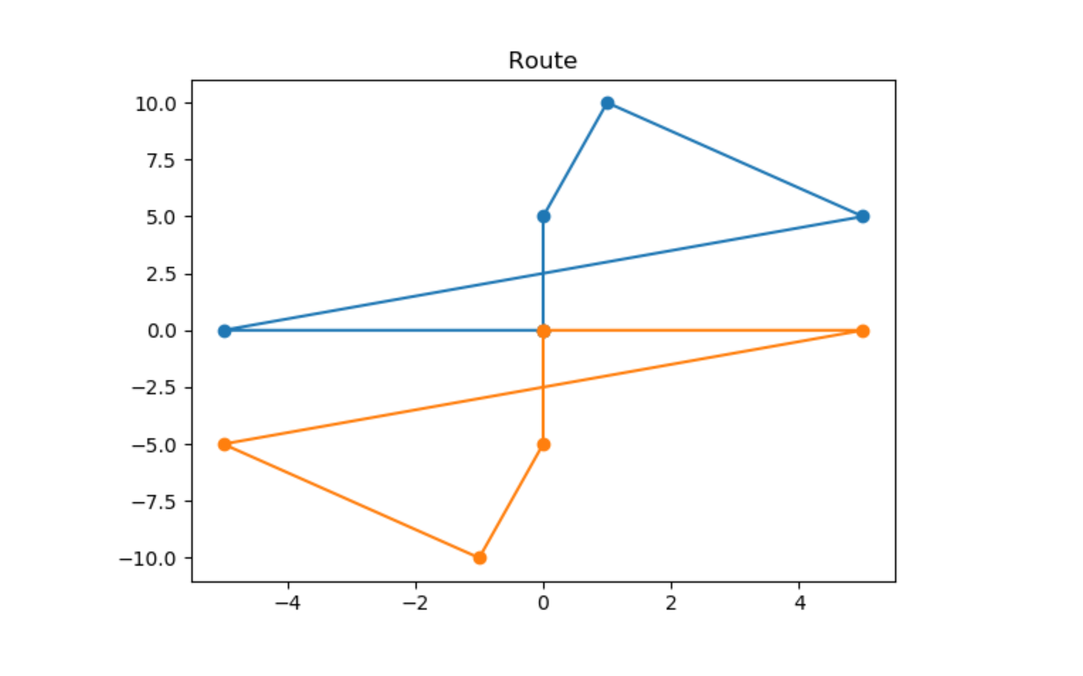
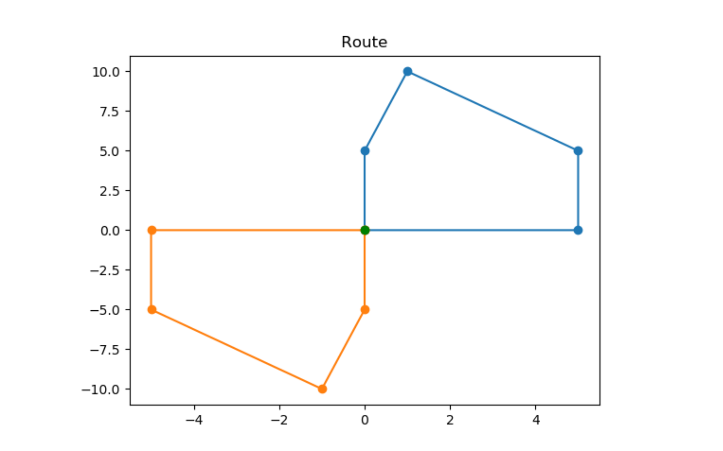
Inter Route Node Swap:
Each node(that satisfies the swap inequality) in the last bus’ route is swapped with all the other nodes in all the other bus’ routes. If the new solution satisfies the the occupancy list inequality(0<=(OL)i<=occupancy-minOccupancy), it is added to the list of possible solutions.
Solution after inter route node swap
Initial solution

Slide 17
Swap inequality
lowerBound=0 upperBound=occupancy-minOccupancy=32-28=4
If occupanyList[lastRoute]>4:
(occupancyList[lastRoute]-upperBound) <= (node(lastRoute)-node(otherRoute)) <= (upperBound-occupancyList[otherRoute])
If occupanyList[lastRoute]<0:
(lowerBound-occupancyList[lastRoute]) <= (node(otherRoute)-node(lastRoute)) <= (occupancyList[otherRoute])

Slide 18
Results
[4, 0, 4] [['Bosch Bidadi', 'Uttrahalli road', 'Rajarajeshwari', 'Devegowda', 'RR nagar busStop', 'Kanthi Sweets', 'Kodipalya', 'Bosch Bidadi'], ['Bosch Bidadi', 'Jantha', 'Hosakarehalli', 'RNSIT', 'Ittamadu', 'KathriGuppe Circle', 'Kathreguppe ', 'Bosch Bidadi'], ['Bosch Bidadi', 'Kamakya', 'Chowdeshwari talkies', 'PESIT', 'Mantri Apartment', 'Bata Show Room', 'Kadirenahalli', 'JayaNagar', 'Bosch Bidadi']]
[4, 0, 4] [['Bosch Bidadi', 'Uttrahalli road', 'Rajarajeshwari', 'PESIT', 'RR nagar busStop', 'Kanthi Sweets', 'Devegowda', 'Bosch Bidadi'], ['Bosch Bidadi', 'Jantha', 'Hosakarehalli', 'RNSIT', 'Ittamadu', 'KathriGuppe Circle', 'Kathreguppe ', 'Bosch Bidadi'], ['Bosch Bidadi', 'Kamakya', 'Chowdeshwari talkies', 'Kodipalya', 'Mantri Apartment', 'Bata Show Room', 'Kadirenahalli', 'JayaNagar', 'Bosch Bidadi']]
[4, 0, 4] [['Bosch Bidadi', 'Uttrahalli road', 'Rajarajeshwari', 'Mantri Apartment', 'RR nagar busStop', 'Kanthi Sweets', 'Kodipalya', 'Bosch Bidadi'], ['Bosch Bidadi', 'Jantha', 'Hosakarehalli', 'RNSIT', 'Ittamadu', 'KathriGuppe Circle', 'Kathreguppe ', 'Bosch Bidadi'], ['Bosch Bidadi', 'Kamakya', 'Chowdeshwari talkies', 'Devegowda', 'PESIT', 'Bata Show Room', 'Kadirenahalli', 'JayaNagar', 'Bosch Bidadi']]
[4, 0, 4] [['Bosch Bidadi', 'Uttrahalli road', 'Rajarajeshwari', 'PESIT', 'RR nagar busStop', 'Kanthi Sweets', 'Mantri Apartment', 'Bosch Bidadi'], ['Bosch Bidadi', 'Jantha', 'Hosakarehalli', 'RNSIT', 'Ittamadu', 'KathriGuppe Circle', 'Kathreguppe ', 'Bosch Bidadi'], ['Bosch Bidadi', 'Kamakya', 'Chowdeshwari talkies', 'Devegowda', 'Kodipalya', 'Bata Show Room', 'Kadirenahalli', 'JayaNagar', 'Bosch Bidadi']]
[2, 2, 4] [['Bosch Bidadi', 'Uttrahalli road', 'Rajarajeshwari', 'PESIT', 'RR nagar busStop', 'Kanthi Sweets', 'Kodipalya', 'Bosch Bidadi'], ['Bosch Bidadi', 'Jantha', 'Devegowda', 'RNSIT', 'Ittamadu', 'KathriGuppe Circle', 'Kathreguppe ', 'Bosch Bidadi'], ['Bosch Bidadi', 'Kamakya', 'Chowdeshwari talkies', 'Hosakarehalli', 'Mantri Apartment', 'Bata Show Room', 'Kadirenahalli', 'JayaNagar', 'Bosch Bidadi']]

Slide 19
[2, 2, 4] [['Bosch Bidadi', 'Uttrahalli road', 'Rajarajeshwari', 'PESIT', 'RR nagar busStop', 'Kanthi Sweets', 'Kodipalya', 'Bosch Bidadi'], ['Bosch Bidadi', 'Jantha', 'Hosakarehalli', 'RNSIT', 'Devegowda', 'KathriGuppe Circle', 'Kathreguppe ', 'Bosch Bidadi'], ['Bosch Bidadi', 'Kamakya', 'Chowdeshwari talkies', 'Ittamadu', 'Mantri Apartment', 'Bata Show Room', 'Kadirenahalli', 'JayaNagar', 'Bosch Bidadi']]
[2, 2, 4] [['Bosch Bidadi', 'Uttrahalli road', 'Rajarajeshwari', 'PESIT', 'RR nagar busStop', 'Kanthi Sweets', 'Kodipalya', 'Bosch Bidadi'], ['Bosch Bidadi', 'Jantha', 'Hosakarehalli', 'RNSIT', 'Ittamadu', 'Devegowda', 'Kathreguppe ', 'Bosch Bidadi'], ['Bosch Bidadi', 'Kamakya', 'Chowdeshwari talkies', 'KathriGuppe Circle', 'Mantri Apartment', 'Bata Show Room', 'Kadirenahalli', 'JayaNagar', 'Bosch Bidadi']]
[2, 2, 4] [['Bosch Bidadi', 'Uttrahalli road', 'Rajarajeshwari', 'PESIT', 'RR nagar busStop', 'Kanthi Sweets', 'Kodipalya', 'Bosch Bidadi'], ['Bosch Bidadi', 'Jantha', 'Mantri Apartment', 'RNSIT', 'Ittamadu', 'KathriGuppe Circle', 'Kathreguppe ', 'Bosch Bidadi'], ['Bosch Bidadi', 'Kamakya', 'Chowdeshwari talkies', 'Devegowda', 'Hosakarehalli', 'Bata Show Room', 'Kadirenahalli', 'JayaNagar', 'Bosch Bidadi']]
[2, 2, 4] [['Bosch Bidadi', 'Uttrahalli road', 'Rajarajeshwari', 'PESIT', 'RR nagar busStop', 'Kanthi Sweets', 'Kodipalya', 'Bosch Bidadi'], ['Bosch Bidadi', 'Jantha', 'Hosakarehalli', 'RNSIT', 'Mantri Apartment', 'KathriGuppe Circle', 'Kathreguppe ', 'Bosch Bidadi'], ['Bosch Bidadi', 'Kamakya', 'Chowdeshwari talkies', 'Devegowda', 'Ittamadu', 'Bata Show Room', 'Kadirenahalli', 'JayaNagar', 'Bosch Bidadi']]
[2, 2, 4] [['Bosch Bidadi', 'Uttrahalli road', 'Rajarajeshwari', 'PESIT', 'RR nagar busStop', 'Kanthi Sweets', 'Kodipalya', 'Bosch Bidadi'], ['Bosch Bidadi', 'Jantha', 'Hosakarehalli', 'RNSIT', 'Ittamadu', 'Mantri Apartment', 'Kathreguppe ', 'Bosch Bidadi'], ['Bosch Bidadi', 'Kamakya', 'Chowdeshwari talkies', 'Devegowda', 'KathriGuppe Circle', 'Bata Show Room', 'Kadirenahalli', 'JayaNagar', 'Bosch Bidadi']]

Slide 20
ITERATION PHASE

Slide 21
Iteration on each possible solution
05
In iteration phase we use the search algorithms to iterate to a better solution - a solution with minimum route cost. The search algorithms based on heuristic and meta-heuristic are used. These algorithms avoid getting stuck at local minima (or maxima) by using different strategies. And hence they are very popular whenever a global minima (or maxima) of a function is desired. Several algorithms exist: Tabu Search, Simulated Annealing, Genetic algorithm, Ant colony optimization etc. In our algorithm, we have used Tabu Search.
For each possible solution, all Bus’ routes are iterated and their costs are minimized.
The cost function we use is the length of the route traveled by the buses. Our goal is to minimize the total route traveled. Hence a state with low route cost is better.

Slide 22
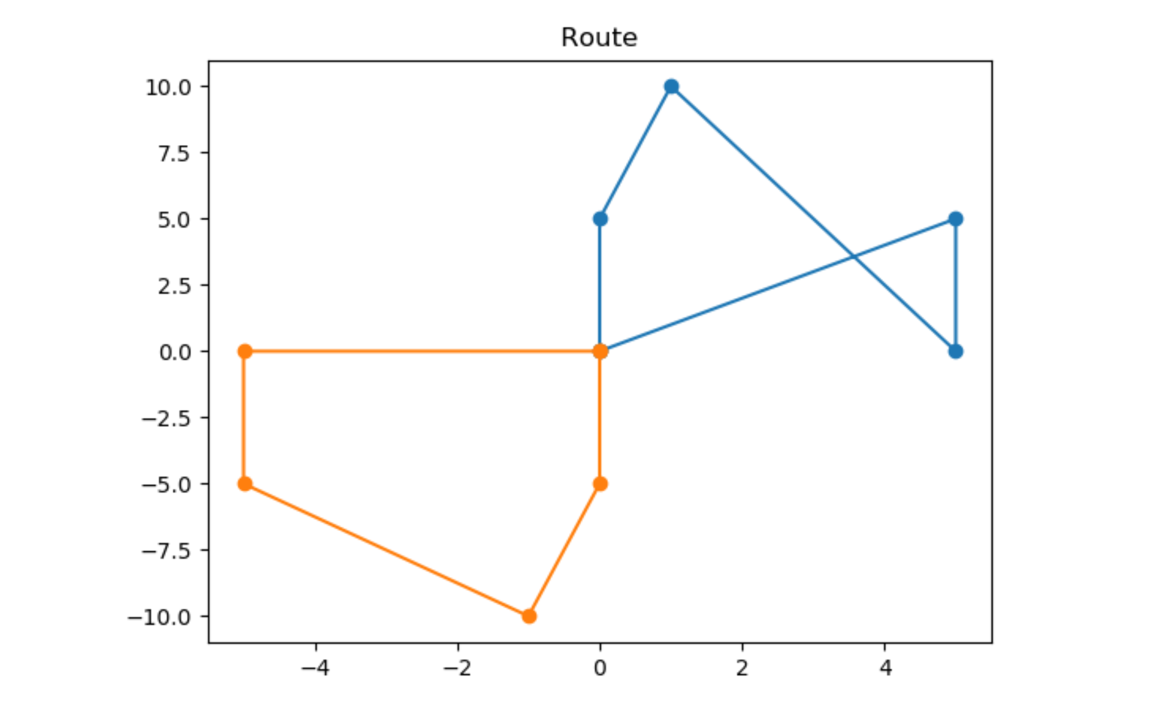
Neighbourhood Generation function
To iterate to a next better state from the current state, our algorithm requires neighbourhood generation function. The neighbourhood generation function produces a list of states that are valid and can be generated from the current state using some strategies. The strategy used here is intra node swap i.e. two nodes of the same route are swapped. The function returns a list of all the neighbour solutions to the given solution sorted according to their costs.

Slide 23
Tabu Search
ALGORITHM:
Input: startSol
Output: bestSol
best = startSol cur = startSol tabu = [cur]
while ¬stoppingCriteria() do
neighbours = neighbor(cur)
neighbours = neighbours−tabu
nxt = neighbours[0]
for i←1 to neighbours.size()− 1 by 1 do
s = neighbours[i]
if cost(s) < cost(nxt) then
nxt = s
end
end
if cost(nxt) < cost(bestSol) then
bestSol = nxt
end
tabu.append(nxt)
if tabu.size() > maxTabuSize then
tabu.removeFirst()
end
cur = nxt
end
return bestSol
Tabu Search enhances the performance of local search by accepting worsening moves if no improving move is available (such as when stuck at local optimum). It uses dynamic memory structures specifying the rules to be used to find the neighbors of the current state. For a given state, it always moves to the best of its neighbors while updating the best VRP solution found so far.

Slide 24
Results along with costs(km)
[['Bosch Bidadi', 'Uttrahalli road', 'Kodipalya', 'RR nagar busStop', 'Kanthi Sweets', 'Devegowda', 'Rajarajeshwari', 'Bosch Bidadi'], ['Bosch Bidadi', 'Jantha', 'Kathreguppe ', 'KathriGuppe Circle', 'Hosakarehalli', 'Ittamadu', 'RNSIT', 'Bosch Bidadi'], ['Bosch Bidadi', 'PESIT', 'Chowdeshwari talkies', 'Kadirenahalli', 'Bata Show Room', 'JayaNagar', 'Mantri Apartment', 'Kamakya', 'Bosch Bidadi']] [61.68, 87.36, 92.76] ---> [60.52, 73.47, 80.1]
[['Bosch Bidadi', 'Rajarajeshwari', 'PESIT', 'Devegowda', 'Kanthi Sweets', 'RR nagar busStop', 'Uttrahalli road', 'Bosch Bidadi'], ['Bosch Bidadi', 'Jantha', 'Kathreguppe ', 'KathriGuppe Circle', 'Hosakarehalli', 'Ittamadu', 'RNSIT', 'Bosch Bidadi'], ['Bosch Bidadi', 'Kamakya', 'Mantri Apartment', 'JayaNagar', 'Bata Show Room', 'Kadirenahalli', 'Chowdeshwari talkies', 'Kodipalya', 'Bosch Bidadi']] [71.92, 87.36, 100.6] ---> [60.669, 73.47, 76.94]
[['Bosch Bidadi', 'Rajarajeshwari', 'Mantri Apartment', 'RR nagar busStop', 'Kanthi Sweets', 'Kodipalya', 'Uttrahalli road', 'Bosch Bidadi'], ['Bosch Bidadi', 'Jantha', 'Kathreguppe ', 'KathriGuppe Circle', 'Hosakarehalli', 'Ittamadu', 'RNSIT', 'Bosch Bidadi'], ['Bosch Bidadi', 'PESIT', 'Chowdeshwari talkies', 'Kadirenahalli', 'JayaNagar', 'Bata Show Room', 'Devegowda', 'Kamakya', 'Bosch Bidadi']] [71.86, 87.36, 89.09] ---> [70.69, 73.47, 78.18]
[['Bosch Bidadi', 'Rajarajeshwari', 'PESIT', 'Mantri Apartment', 'Kanthi Sweets', 'RR nagar busStop', 'Uttrahalli road', 'Bosch Bidadi'], ['Bosch Bidadi', 'Jantha', 'Kathreguppe ', 'KathriGuppe Circle', 'Hosakarehalli', 'Ittamadu', 'RNSIT', 'Bosch Bidadi'], ['Bosch Bidadi', 'Kodipalya', 'Chowdeshwari talkies', 'Kadirenahalli', 'JayaNagar', 'Bata Show Room', 'Devegowda', 'Kamakya', 'Bosch Bidadi']] [77.95, 87.36, 95.95] ---> [69.54, 73.47, 75.04]
[['Bosch Bidadi', 'Rajarajeshwari', 'PESIT', 'Kanthi Sweets', 'RR nagar busStop', 'Kodipalya', 'Uttrahalli road', 'Bosch Bidadi'], ['Bosch Bidadi', 'Jantha', 'Devegowda', 'Kathreguppe ', 'KathriGuppe Circle', 'Ittamadu', 'RNSIT', 'Bosch Bidadi'], ['Bosch Bidadi', 'Chowdeshwari talkies', 'Kadirenahalli', 'Bata Show Room', 'JayaNagar', 'Mantri Apartment', 'Kamakya', 'Hosakarehalli', 'Bosch Bidadi']] [56.65, 87.72, 92.73] ---> [55.49, 72.93, 81.01]
[['Bosch Bidadi', 'Rajarajeshwari', 'PESIT', 'Kanthi Sweets', 'RR nagar busStop', 'Kodipalya', 'Uttrahalli road', 'Bosch Bidadi'], ['Bosch Bidadi', 'Jantha', 'Devegowda', 'Kathreguppe ', 'KathriGuppe Circle', 'Hosakarehalli', 'RNSIT', 'Bosch Bidadi'], ['Bosch Bidadi', 'Kamakya', 'Mantri Apartment', 'JayaNagar', 'Bata Show Room', 'Kadirenahalli', 'Chowdeshwari talkies', 'Ittamadu', 'Bosch Bidadi']] [56.65, 89.6, 90.93] ---> [55.49, 74.21, 80.17]

Slide 25
['Bosch Bidadi', 'Rajarajeshwari', 'PESIT', 'Kanthi Sweets', 'RR nagar busStop', 'Kodipalya', 'Uttrahalli road', 'Bosch Bidadi'], ['Bosch Bidadi', 'Jantha', 'Devegowda', 'Kathreguppe ', 'Hosakarehalli', 'Ittamadu', 'RNSIT', 'Bosch Bidadi'], ['Bosch Bidadi', 'Chowdeshwari talkies', 'Kadirenahalli', 'Bata Show Room', 'JayaNagar', 'Mantri Apartment', 'Kamakya', 'KathriGuppe Circle', 'Bosch Bidadi']] [56.65, 90.17, 89.18] ---> [55.489, 75.41, 79.73]
[['Bosch Bidadi', 'Rajarajeshwari', 'PESIT', 'Kanthi Sweets', 'RR nagar busStop', 'Kodipalya', 'Uttrahalli road', 'Bosch Bidadi'], ['Bosch Bidadi', 'Jantha', 'Mantri Apartment', 'Kathreguppe ', 'KathriGuppe Circle', 'Ittamadu', 'RNSIT', 'Bosch Bidadi'], ['Bosch Bidadi', 'Hosakarehalli', 'Chowdeshwari talkies', 'Kadirenahalli', 'JayaNagar', 'Bata Show Room', 'Devegowda', 'Kamakya', 'Bosch Bidadi']] [56.65, 88.62, 89.05] ---> [55.489, 73.009, 79.11]
[['Bosch Bidadi', 'Rajarajeshwari', 'PESIT', 'Kanthi Sweets', 'RR nagar busStop', 'Kodipalya', 'Uttrahalli road', 'Bosch Bidadi'], ['Bosch Bidadi', 'RNSIT', 'Hosakarehalli', 'KathriGuppe Circle', 'Kathreguppe ', 'Mantri Apartment', 'Jantha', 'Bosch Bidadi'], ['Bosch Bidadi', 'Ittamadu', 'Chowdeshwari talkies', 'Kadirenahalli', 'JayaNagar', 'Bata Show Room', 'Devegowda', 'Kamakya', 'Bosch Bidadi']] [56.65, 97.62, 87.97] ---> [55.489, 74.289, 78.270]
[['Bosch Bidadi', 'Rajarajeshwari', 'PESIT', 'Kanthi Sweets', 'RR nagar busStop', 'Kodipalya', 'Uttrahalli road', 'Bosch Bidadi'], ['Bosch Bidadi', 'Jantha', 'Mantri Apartment', 'Kathreguppe ', 'Hosakarehalli', 'Ittamadu', 'RNSIT', 'Bosch Bidadi'], ['Bosch Bidadi', 'KathriGuppe Circle', 'Chowdeshwari talkies', 'Kadirenahalli', 'JayaNagar', 'Bata Show Room', 'Devegowda', 'Kamakya', 'Bosch Bidadi']] [56.65, 97.44, 85.35] ---> [55.489, 75.49, 77.830]

Slide 26
Filtering out solutions that follow the time frame
06
We removed the solutions in which the maximum time a Bus’ route take to start from Depot and come back to Depot is more than 135 minutes. We got the following solutions:
[['Bosch Bidadi', 'Rajarajeshwari', 'Mantri Apartment', 'RR nagar busStop', 'Kanthi Sweets', 'Kodipalya', 'Uttrahalli road', 'Bosch Bidadi'], ['Bosch Bidadi', 'Jantha', 'Kathreguppe ', 'KathriGuppe Circle', 'Hosakarehalli', 'Ittamadu', 'RNSIT', 'Bosch Bidadi'], ['Bosch Bidadi', 'PESIT', 'Chowdeshwari talkies', 'Kadirenahalli', 'JayaNagar', 'Bata Show Room', 'Devegowda', 'Kamakya', 'Bosch Bidadi']] COST:[70.69, 73.47, 78.18] TIME:[123.6, 130.63, 128.609]
[['Bosch Bidadi', 'Rajarajeshwari', 'PESIT', 'Mantri Apartment', 'Kanthi Sweets', 'RR nagar busStop', 'Uttrahalli road', 'Bosch Bidadi'], ['Bosch Bidadi', 'Jantha', 'Kathreguppe ', 'KathriGuppe Circle', 'Hosakarehalli', 'Ittamadu', 'RNSIT', 'Bosch Bidadi'], ['Bosch Bidadi', 'Kodipalya', 'Chowdeshwari talkies', 'Kadirenahalli', 'JayaNagar', 'Bata Show Room', 'Devegowda', 'Kamakya', 'Bosch Bidadi']] COST:[69.539, 73.47, 75.039] TIME:[127.82, 130.63, 132.09]

Slide 27
Choose the solution with least total cost as final solution
07
BUS1:['Bosch Bidadi', 'Rajarajeshwari', 'PESIT', 'Mantri Apartment', 'Kanthi Sweets', 'RR nagar busStop', 'Uttrahalli road', 'Bosch Bidadi']
BUS2:['Bosch Bidadi', 'Jantha', 'Kathreguppe ', 'KathriGuppe Circle', 'Hosakarehalli', 'Ittamadu', 'RNSIT', 'Bosch Bidadi']
BUS3:['Bosch Bidadi', 'Kodipalya', 'Chowdeshwari talkies', 'Kadirenahalli', 'JayaNagar', 'Bata Show Room', 'Devegowda', 'Kamakya', 'Bosch Bidadi']
TOTAL COST = 218.05 Km
COST:[69.539, 73.47, 75.039] TIME:[127.82, 130.63, 132.09]

Slide 28
CHALLENGES FACED?

Slide 29
Thank you.

